Slide 1
Sectors |  | Document Required | Solution Name for 890 | Comments
Insurance – Agent Onboarding | B2B
Insurance – Customer Onboarding | B2C
Retail Banking | B2C
Wealth Management | B2B/B2C
Commercial Banking | B2B
Telecom | B2C
E&U – Vendor Onboarding | B2B
Issurer/Acquirer – Merchant Onboarding | B2B
Healthcare – Patient Onboarding | B2C

Slide 2
Aerospace
Automotive
Banking
Communication Service Providers
Consumer Goods
Energy
Engineering & Construction
Government
Healthcare
Hi-Tech
Insurance
Manufacturing
Media
Medical Devices
Natural Resources
Pharmaceutical and Life Sciences
Professional Services
Retail
Securities and Capital Markets
Network Equipment Provider
Transportation
Utilities

Slide 3

1
2
3
4
5
6
User select and upload files to server
Data Extraction From Converted Files
OCR: Extra text information from Uploaded Image Files
Render results to Users

Slide 4



Slide 5

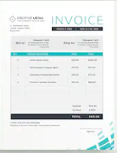

1
2
3
4
5
6
Please select the document to process :
SELECT
SELECT

Slide 6
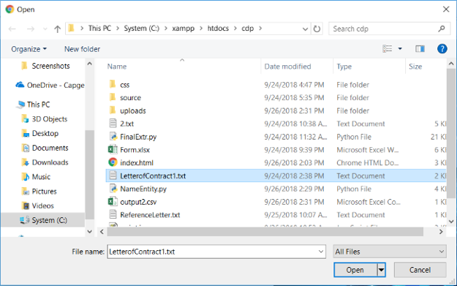
1
2
3
4
5
6
Please select the document to process :
SELECT
SELECT
SELECT

Slide 7

1
2
3
4
5
6
Files selected
Xxxxxxx
Xxxxxxx
Xxxxxxxxx
Xxxxxxxx
Xxxxxxxxxx
Xxxxxxxxxx
Image to Text Conversion

Slide 8
1
2
3
4
5
6
Files selected
Xxxxxxx
Xxxxxxx
Xxxxxxxxx
Xxxxxxxx
Xxxxxxxxxx
Xxxxxxxxxx
Xxxxxxx
Xxxxxxx
Xxxxxxxxx
Xxxxxxxx
Xxxxxxxxxx
Xxxxxxxxxx
Submit

Slide 9
1
2
3
4
5
6
Files selected
Xxxxxxx
Xxxxxxx
Xxxxxxxxx
Xxxxxxxx
Xxxxxxxxxx
Xxxxxxxxxx
Data Extraction

Slide 10
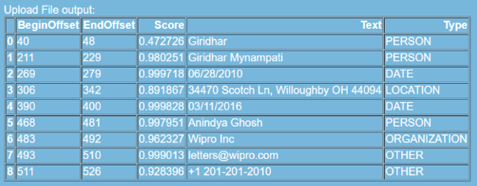
1
2
3
4
5
6
Files selected
Xxxxxxx
Xxxxxxx
Xxxxxxxxx
Xxxxxxxx
Xxxxxxxxxx
Xxxxxxxxxx
Data Extraction

Slide 11
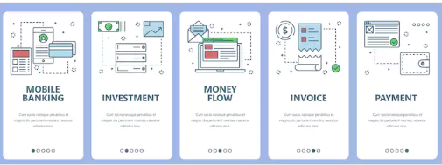
ALTERNATE DESIGN FOR SLIDE 4
Please select the document to process :

